Slide 1
Hypothesis Test for
Two Proportions

Slide 2
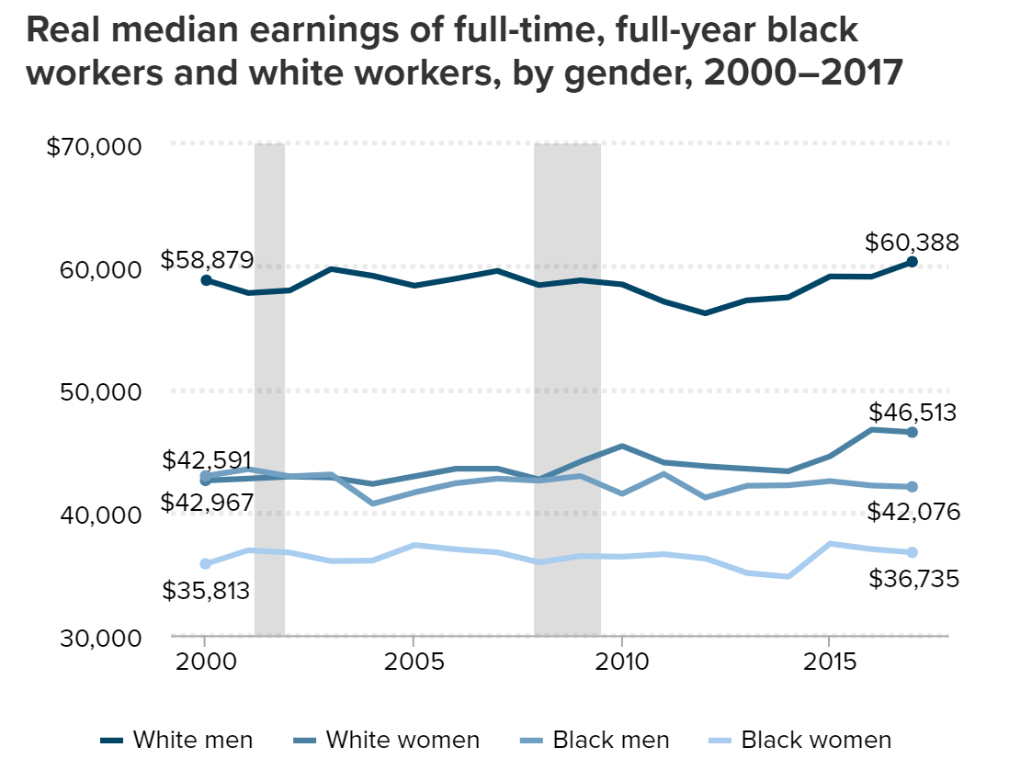
Hiring discrimination
Researchers wanted to test if hiring discrimination was a factor in labor markets
Economic Policy Institute, 2018: https://www.epi.org/blog/black-workers-have-made-no-progress-in-closing-earnings-gaps-with-white-men-since-2000/

Slide 3
The Race/Resumé Study
Resumé
Greg Baker
University of Massachusetts, Lowell
Major: Business, GPA: 3.5
Experience
Sales Consultant, Summer 2011
___________________________________________________________________________
Development Intern, Spring 2010
_________________________________________________________________________________________________
Resumé
Jamal Jones
University of Massachusetts, Lowell
Major: Business, GPA: 3.5
Experience
Sales Consultant, Summer 2011
___________________________________________________________________________
Development Intern, Spring 2010
_________________________________________________________________________________________________
Greg Baker
Jamal Jones

Slide 4
The jobs
Wide swath of jobs in the following industries: sales, administrative support, clerical services, and customer services
Large range of positions, from “cashier work at retail establishments and clerical work in a mailroom to office and sales management positions.”

Slide 5

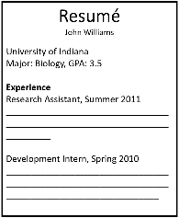
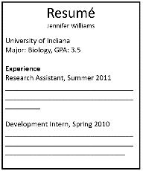
The Race/Resumé Study
n = 4890
employers
Greg
Jamal

Slide 6
The Race/Resumé Study
Measured which group got more callbacks from potential employers
Greg
Jamal
n₁ = 2445
n₂ = 2445

Slide 7


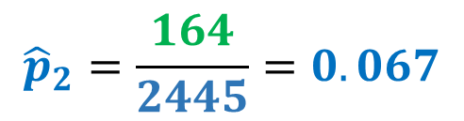
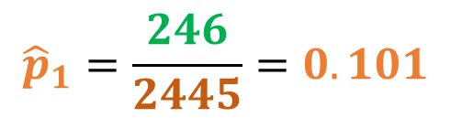
The results
Treatment 1
Treatment 2
 | Commonly-White Names | Commonly-Black Names | Total
Called back | 246 | 164 | 410
Not called back | 2199 | 2281 | 4480
Total | 2445 | 2445 | 4890
Comparing the proportion who received callbacks from both treatments.
$$n_{1}=2445$$
$$n_{2}=2445$$
$${\hat{p}}_{1}=\frac{246}{2445}=0.101$$
$${\hat{p}}_{2}=\frac{164}{2445}=0.067$$

Slide 8
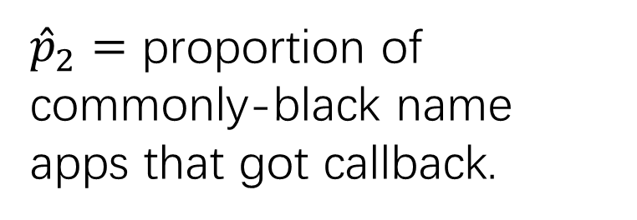
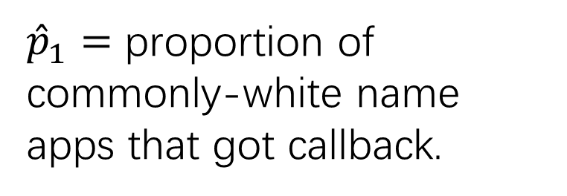
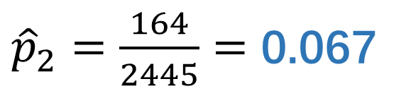
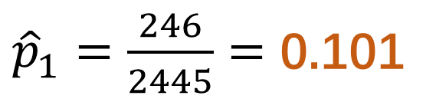

Two-Sample Situation
If there’s hiring discrimination, ${\hat{p}}_{1}>{\hat{p}}_{2}$
Group 1: White
Group 2: Black
${\hat{p}}_{1}=$ proportion of commonly-white name apps that got callback.
>
${\hat{p}}_{2}=$ proportion of commonly-black name apps that got callback.
>
${\hat{p}}_{1}=\frac{246}{2445}=$ 0.101
${\hat{p}}_{2}=\frac{164}{2445}=$ 0.067
Are these proportions different enough to show discrimination, or could this difference have been a result of chance alone?

Slide 9
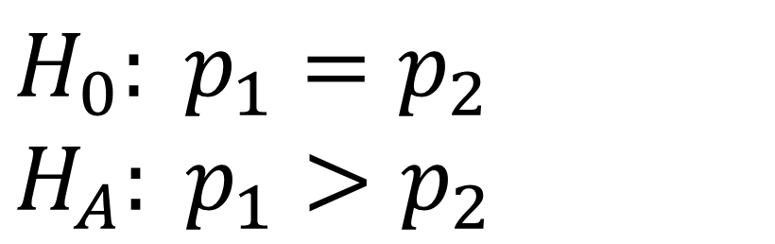
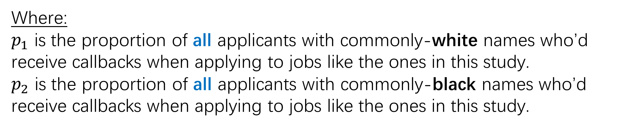
Hypotheses
There is no discrimination, so the callback rate is the same in both groups. You’re seeing if there’s evidence to reject this default claim.
$$H_{0}: p_{1}=p_{2}$$
$H_{A}: p_{1}>p_{2}$
There is discrimination, in which case the commonly-white named applications received a higher rate of callbacks.
Where:
$p_{1}$ is the proportion of all applicants with commonly-white names who’d receive callbacks when applying to jobs like the ones in this study.
$p_{2}$ is the proportion of all applicants with commonly-black names who’d receive callbacks when applying to jobs like the ones in this study.

Slide 10

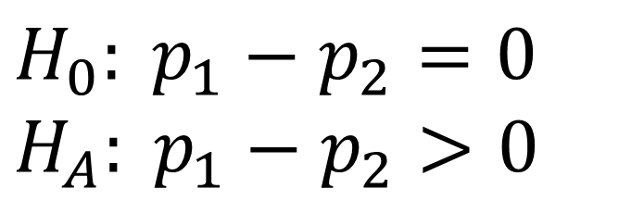
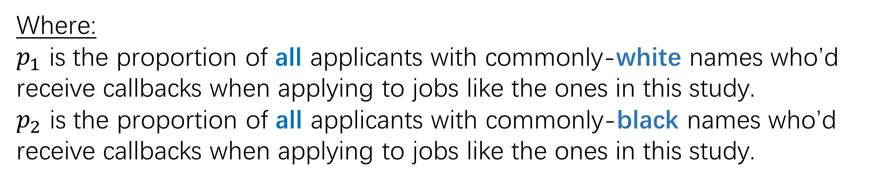

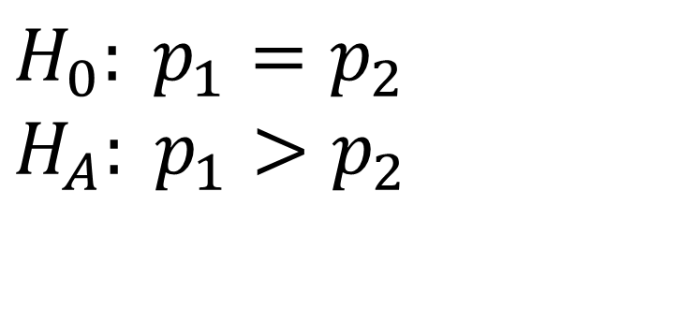
Setting up the Hypotheses
$$H_{0}: p_{1}=p_{2}$$
$$H_{A}: p_{1}>p_{2}$$
$H_{0}: p_{1}−p_{2}=0$
$H_{A}: p_{1}−p_{2}>0$
$$OR$$
❤$Preferred$❤
Where:
$p_{1}$ is the proportion of all applicants with commonly-white names who’d receive callbacks when applying to jobs like the ones in this study.
$p_{2}$ is the proportion of all applicants with commonly-black names who’d receive callbacks when applying to jobs like the ones in this study.

Slide 11

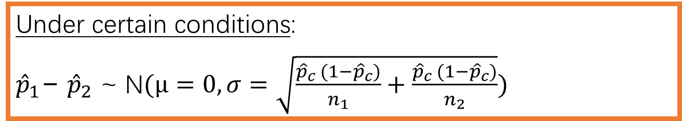
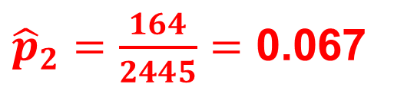
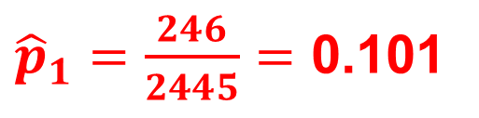
Calculations
Since null assumes $p_{1}$= $p_{2}$, so we can combine the proportion who got callbacks into one estimate: ${\hat{p}}_{c}$
Under certain conditions:
${\hat{p}}_{1}\text{− }{\hat{p}}_{2}$ ~ N$(μ=0, σ=\sqrt{\frac{{\hat{p}}_{c} (1−{\hat{p}}_{c})}{n_{1}}+\frac{{\hat{p}}_{c} (1−{\hat{p}}_{c})}{n_{2}}})$
${\hat{p}}_{1}=\frac{246}{2445}=$ 0.101
Centered at zero (since null assumes no difference between callback rates)
${\hat{p}}_{2}=\frac{164}{2445}=$ 0.067
Combined proportion ${\hat{p}}_{c}=\frac{246+164}{2445+2445}=$ 0.084

Slide 12
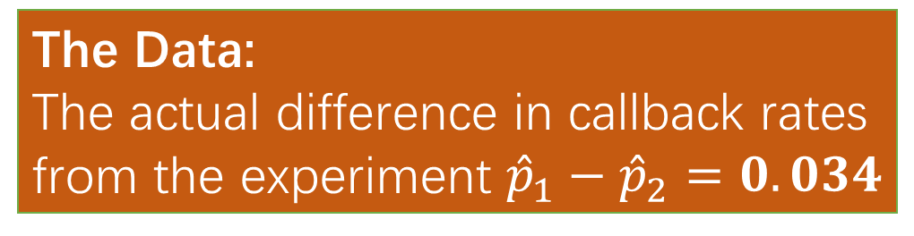
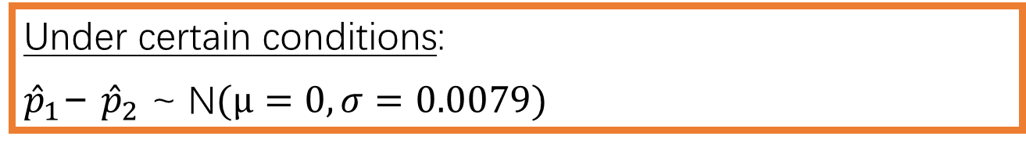
Calculations
Since null assumes $p_{1}$= $p_{2}$, so we can combine the proportion who got callbacks into one estimate: ${\hat{p}}_{c}$
The Data:
The actual difference in callback rates from the experiment ${\hat{p}}_{1}−{\hat{p}}_{2}=0.034$
Under certain conditions:
${\hat{p}}_{1}\text{− }{\hat{p}}_{2}$ ~ N$(μ=0, σ=0.0079)$
How unlikely was our data?
${\hat{p}}_{1}=\frac{246}{2445}=$ 0.101
Centered at zero (since null assumes no difference between callback rates)
Check the p-value!
${\hat{p}}_{2}=\frac{164}{2445}=$ 0.067
Combined proportion ${\hat{p}}_{c}=\frac{246+164}{2445+2445}=$ 0.084

Slide 13
Conclusion
Under my assumption that there is no difference in callback rates, the actually observed data (a 3.4% difference in callback rates among 4890 employers) is highly unlikely (p-value = 0.00001 < alpha level of 0.05). So, I reject my earlier assumption. There’s convincing evidence that commonly-white named resumés receive a higher callback rate.

Slide 14
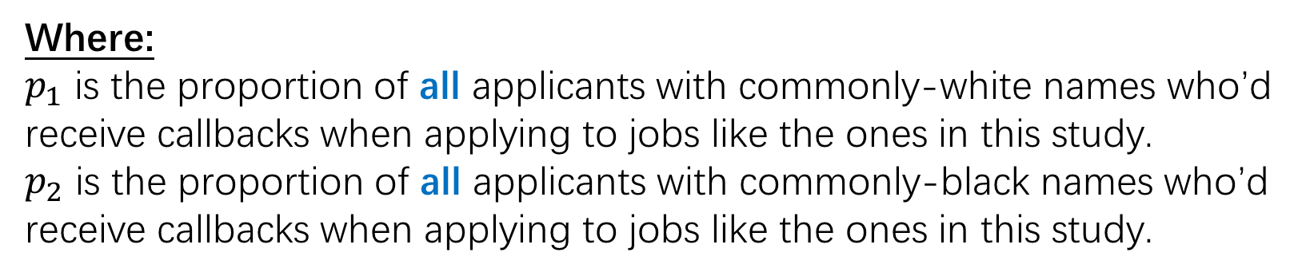
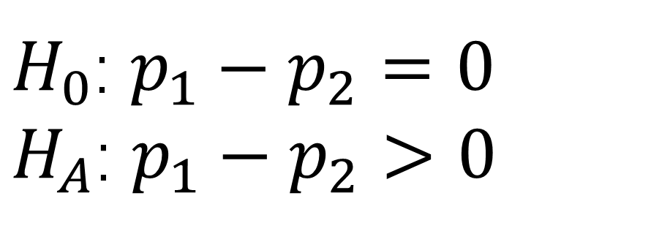
State-Plan-Do-Conclude
State: State the hypotheses, significance level, and define your parameters
$H_{0}$: $p_{1}−p_{2}=0$
$H_{A}$: $p_{1}−p_{2}>0$
α = 0.05
Where:
$p_{1}$ is the proportion of all applicants with commonly-white names who’d receive callbacks when applying to jobs like the ones in this study.
$p_{2}$ is the proportion of all applicants with commonly-black names who’d receive callbacks when applying to jobs like the ones in this study.

Slide 15
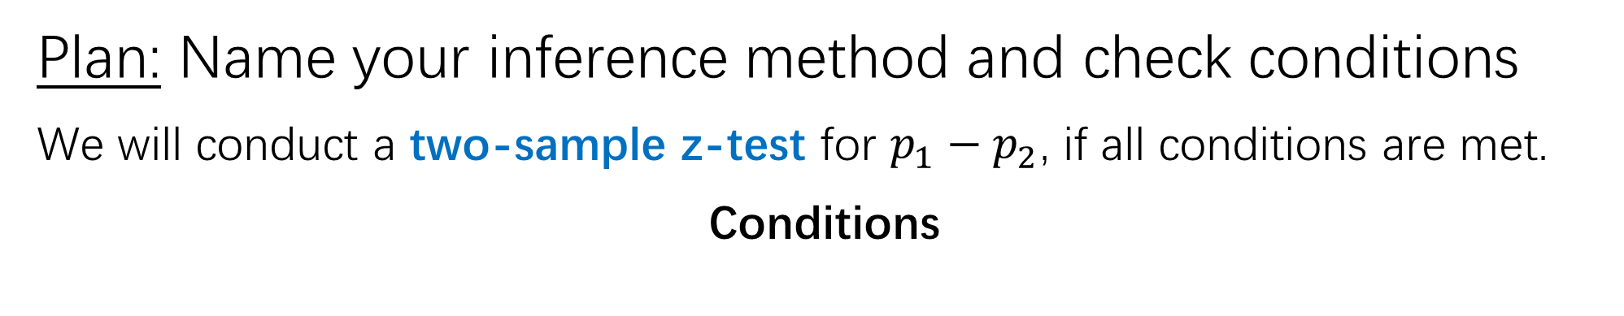
State-Plan-Do-Conclude
Plan: Name your inference method and check conditions
We will conduct a two-sample z-test for $p_{1}−p_{2}$, if all conditions are met.
Conditions

Slide 16
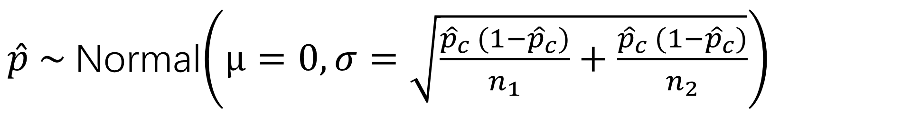
Recall: Why we check conditions
$\hat{p} \sim$Normal$\left(μ=0, σ=\sqrt{\frac{{\hat{p}}_{c} (1−{\hat{p}}_{c})}{n_{1}}+\frac{{\hat{p}}_{c} (1−{\hat{p}}_{c})}{n_{2}}}\right)$
2) 10% condition
→ calculable spread
3) Large counts
→ approx. normal
shape
1) Random condition
→ unbiased center

Slide 17

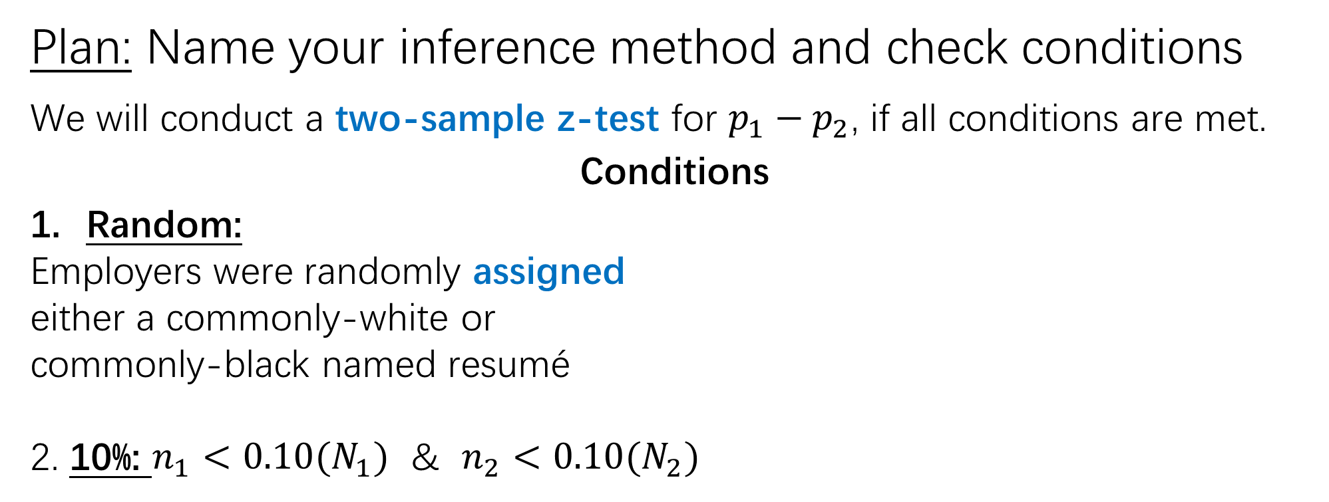


State-Plan-Do-Conclude
Plan: Name your inference method and check conditions
We will conduct a two-sample z-test for $p_{1}−p_{2}$, if all conditions are met.
Conditions
Random:
Employers were randomly assigned
either a commonly-white or
commonly-black named resumé
2. 10%: $n_{1}<0.10(N_{1})$ & $n_{2}<0.10(N_{2})$
3. Large Counts:
$$n_{1}{\hat{p}}_{c}≥10$$
$$n_{1}(1−{\hat{p}}_{c})≥10$$
$$n_{2}{\hat{p}}_{c}≥10$$
$$n_{2}(1−{\hat{p}}_{c})≥10$$
Only have to do 10% when sampling. However, this is an experiment. We don’t have to check this condition!

Slide 18
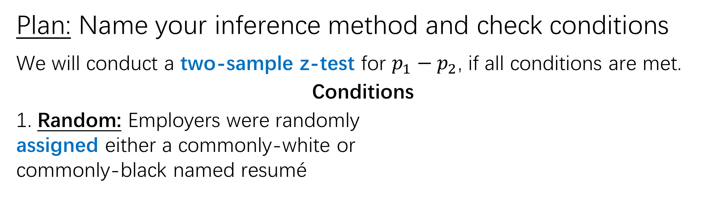


State-Plan-Do-Conclude
Plan: Name your inference method and check conditions
We will conduct a two-sample z-test for $p_{1}−p_{2}$, if all conditions are met.
Conditions
1. Random: Employers were randomly
assigned either a commonly-white or
commonly-black named resumé
2. Large Counts:
$$n_{1}{\hat{p}}_{c}≥10$$
$$\left(2445\right)(.084) ≥10$$
$$n_{1}(1−{\hat{p}}_{c})≥10$$
$$\left(2445\right)(1−.084) ≥10$$
$$n_{2}{\hat{p}}_{c}≥10$$
$$\left(2445\right)(.084) ≥10$$
$$n_{2}(1−{\hat{p}}_{c})≥10$$
$$\left(2445\right)(1−.084) ≥10$$

Slide 19



State-Plan-Do-Conclude
Plan: Name your inference method and check conditions
We will conduct a two-sample z-test for $p_{1}−p_{2}$, if all conditions are met.
Conditions
1. Random: Employers were randomly
assigned either a commonly-white or
commonly-black named resumé
2. Large Counts:
$$n_{1}{\hat{p}}_{c}≥10$$
$$205.4≥10$$
$$n_{1}(1−{\hat{p}}_{c})≥10$$
$$2239.6≥10$$
$$n_{2}{\hat{p}}_{c}≥10$$
$$205.4≥10$$
$$n_{2}(1−{\hat{p}}_{c})≥10$$
$$2239.6≥10$$

Slide 20
State-Plan-Do-Conclude
Do: Perform calculations (if conditions met), report the test statistic and the p-value
z = 4.231
p-value = 0.00001

Slide 21
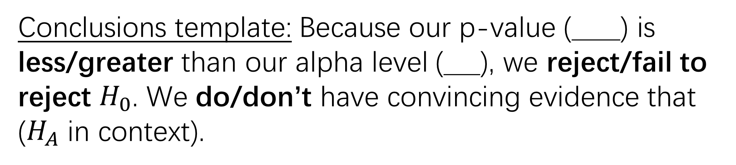
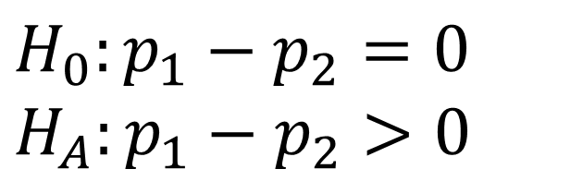
State-Plan-Do-Conclude
Conclude: Reject or fail to reject $H_{0}$ and justify
$$H_{0}:p_{1}−p_{2}=0$$
$$H_{A}:p_{1}−p_{2}>0$$
z = 4.231
p-value = 0.00001
α = 0.05
Conclusions template: Because our p-value (____) is less/greater than our alpha level (___), we reject/fail to reject $H_{0}$. We do/don’t have convincing evidence that ($H_{A}$ in context).

Slide 22
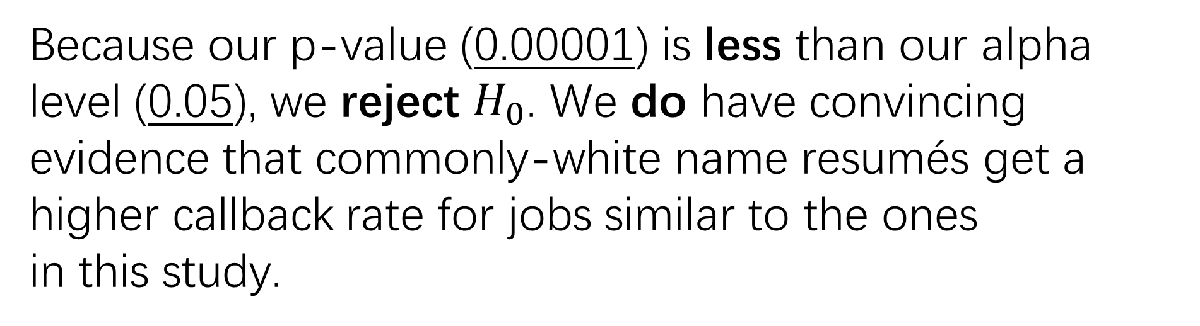
State-Plan-Do-Conclude
Conclude: Reject or fail to reject $H_{0}$ and justify
$$H_{0}:p_{1}−p_{2}=0$$
$$H_{A}:p_{1}−p_{2}>0$$
z = 4.231
p-value = 0.00001
α = 0.05
Because our p-value (0.00001) is less than our alpha level (0.05), we reject $H_{0}$. We do have convincing evidence that commonly-white name resumés get a higher callback rate for jobs similar to the ones
in this study.

Slide 23
Hypothesis Test for
Two Means

Slide 24
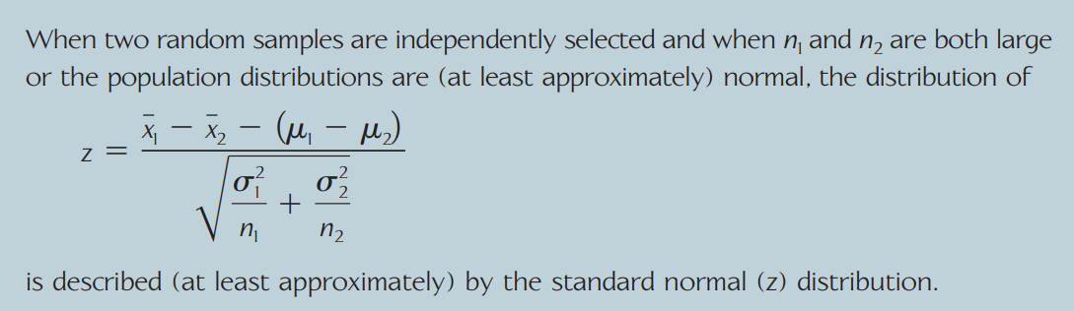
Standard deviations known

Slide 25
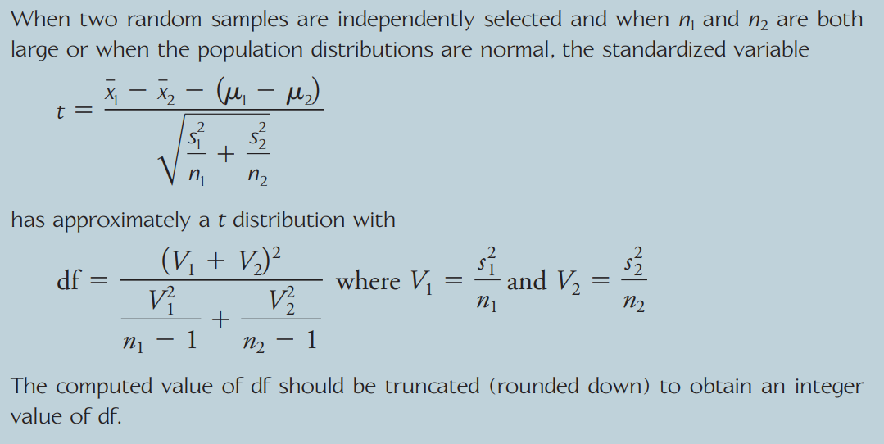
Standard deviations unknown

Slide 26
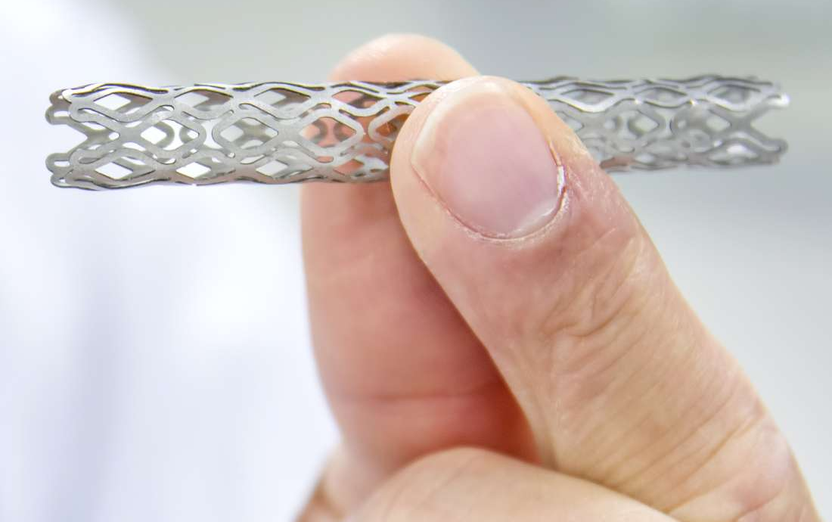
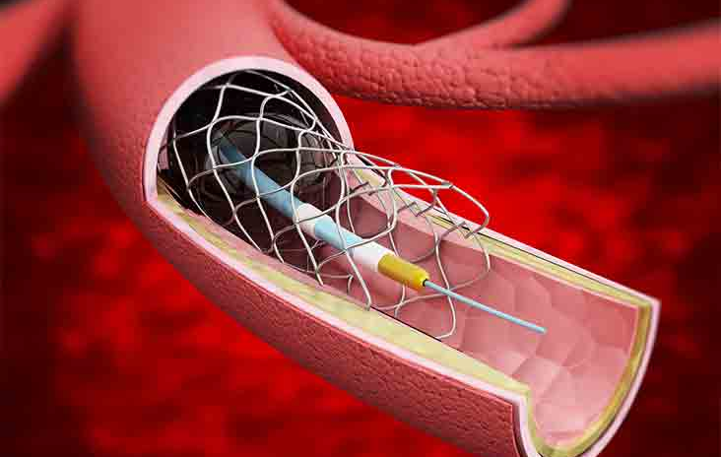
Today’s Key Analysis
Did the stent treatment work?

Slide 27
Measurement of Outcome
No Symptoms
Death
0 1 2 3 4 5 6
If stent works, it will move patients down this scale

Slide 28
Measurement of Outcome
No Symptoms
Death
0 1 2 3 4 5 6
From here on: referred to as “disability score”

Slide 29


Our Study
*Random Assignment*
n = 191 stroke patients
Standard Care
Standard + Stent

Slide 30



Our Study
Standard Care
Standard + Stent
n₁ = 93
n₂ = 98

Slide 31
Our Study
Measured which group had lower mean disability score
Standard Care
Standard + Stent
n₁ = 93
n₂ = 98

Slide 32
Topics
Two-sample t-test for a difference of means
Four step process

Slide 33
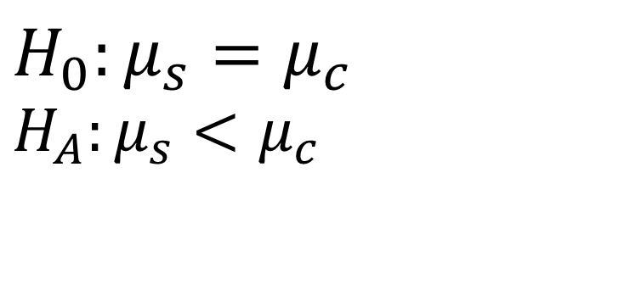
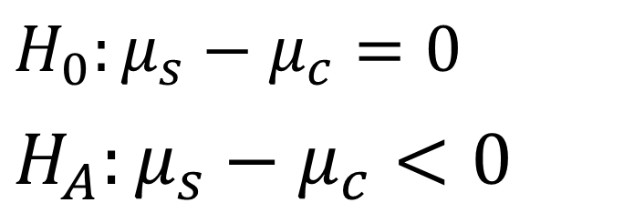
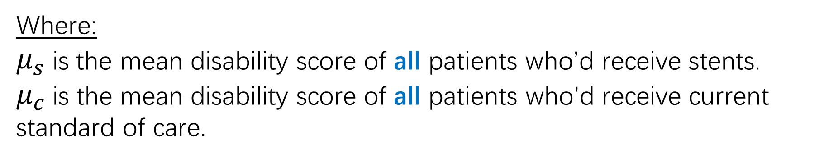
Setting up the Hypotheses
$$H_{0}:μ_{s}=μ_{c}$$
$$H_{A}:μ_{s}<μ_{c}$$
$H_{0}:μ_{s}−μ_{c}=0$
$H_{A}:μ_{s}−μ_{c}<0$
Where:
$μ_{s}$ is the mean disability score of all patients who’d receive stents.
$μ_{c}$is the mean disability score of all patients who’d receive current standard of care.

Slide 34
The results
 | Stent | Control
Mean Disability | 2.26 | 3.23
Stdev. Disability | 1.78 | 1.78
n | 98 | 93
Saver JL, Goyal M, Bonafe A, Diener HC, Levy EI, Pereira VM, et al. “Stent-retriever thrombectomy after intravenous t-pa vs. T-pa alone in stroke.” N Engl J Med. 2015; 372:2285-2295 https://www.nejm.org/doi/full/10.1056/nejmoa1415061

Slide 35

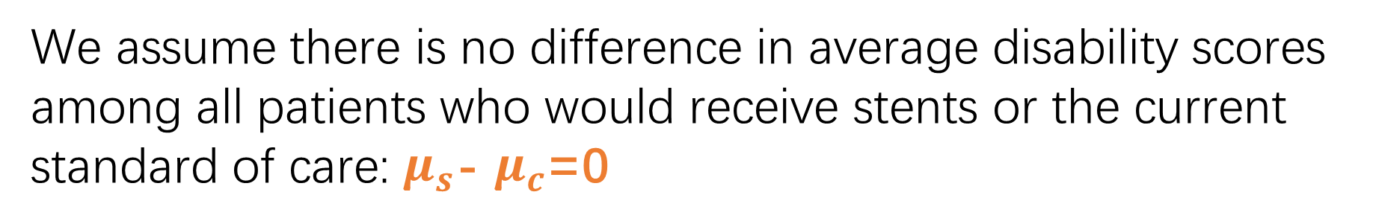
The Calculations
1. Assume the null is true
$$H_{0}：μ_{s}\text{− }μ_{c}\text{=0}$$
-1.25
-1.0
-.75
-.50
-.25
0
.25
.50
.75
We assume there is no difference in average disability scores among all patients who would receive stents or the current standard of care: $μ_{s}$- $μ_{c}$=0

Slide 36
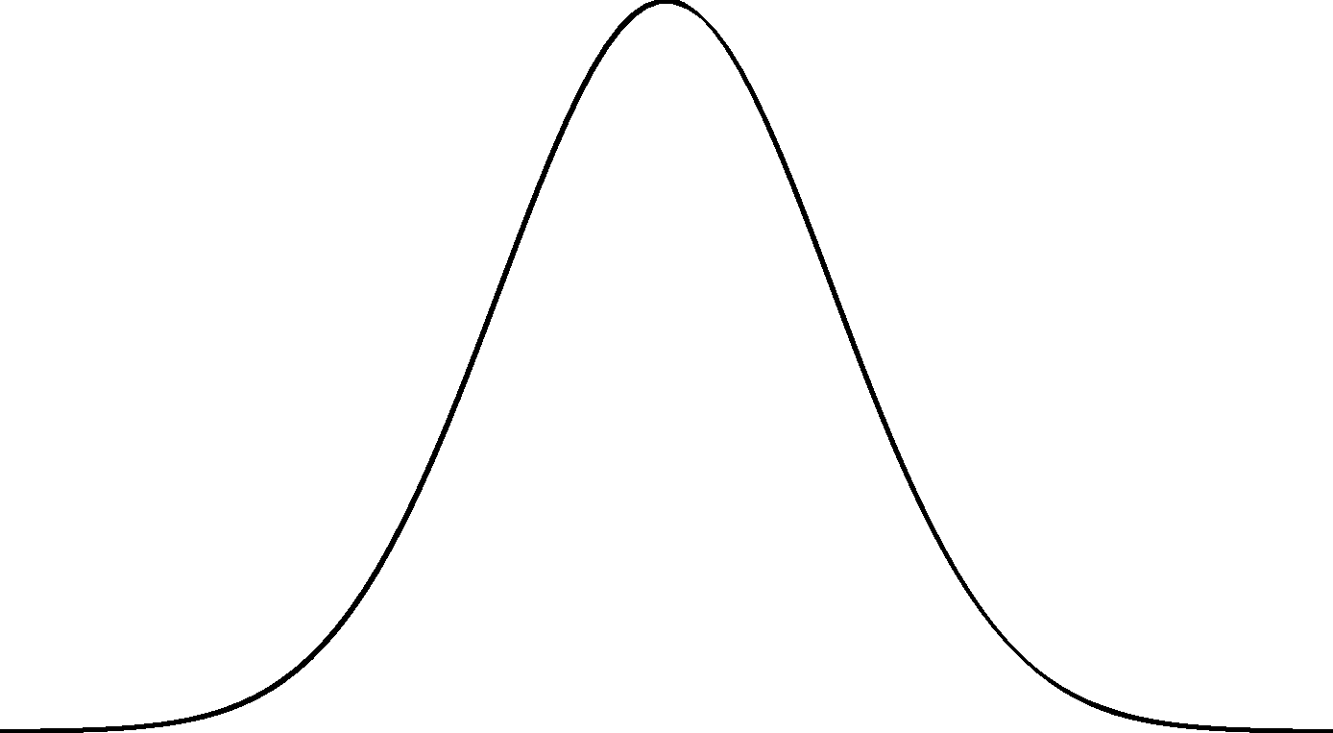
















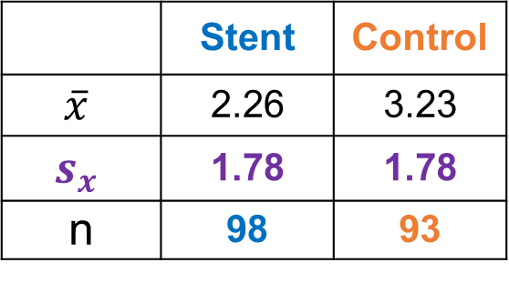





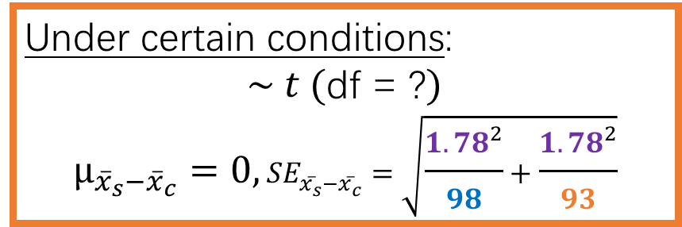
The Calculations
2. If the null is in fact true, how likely is the data that you’ve gathered?
The study enrolled 191 patients (93 in control, 98 in treatment).
Let’s find the sampling distribution of ${\overline{x}}_{s}$- ${\overline{x}}_{c}$.
 | Stent | Control
$$\overline{x}$$ | 2.26 | 3.23
$$s_{x}$$ | 1.78 | 1.78
n | 98 | 93
Under certain conditions:
$\sim t$ (df = ?)
$$μ_{{\overline{x}}_{s}−{\overline{x}}_{c}}=0, {SE}_{{\overline{x}}_{s}−{\overline{x}}_{c}}=\sqrt{\frac{{1.78}^{2}}{98}+\frac{{1.78}^{2}}{93}}$$
$${\overline{x}}_{s}−{\overline{x}}_{c}$$
$${\overline{x}}_{s}−{\overline{x}}_{c}$$
$${\overline{x}}_{s}−{\overline{x}}_{c}$$
$${\overline{x}}_{s}−{\overline{x}}_{c}$$
$${\overline{x}}_{s}−{\overline{x}}_{c}$$
$${\overline{x}}_{s}−{\overline{x}}_{c}$$
$${\overline{x}}_{s}−{\overline{x}}_{c}$$
$${\overline{x}}_{s}−{\overline{x}}_{c}$$
$${\overline{x}}_{s}−{\overline{x}}_{c}$$
$${\overline{x}}_{s}−{\overline{x}}_{c}$$
$${\overline{x}}_{s}−{\overline{x}}_{c}$$
$${\overline{x}}_{s}−{\overline{x}}_{c}$$
$${\overline{x}}_{s}−{\overline{x}}_{c}$$
$${\overline{x}}_{s}−{\overline{x}}_{c}$$
$${\overline{x}}_{s}−{\overline{x}}_{c}$$
$${\overline{x}}_{s}−{\overline{x}}_{c}$$
$${\overline{x}}_{s}−{\overline{x}}_{c}$$
$${\overline{x}}_{s}−{\overline{x}}_{c}$$
$${\overline{x}}_{s}−{\overline{x}}_{c}$$
$${\overline{x}}_{s}−{\overline{x}}_{c}$$
$${\overline{x}}_{s}−{\overline{x}}_{c}$$
$${\overline{x}}_{s}−{\overline{x}}_{c}$$
-1.25
-1.0
-.75
-.50
-.25
0
.25
.50
.75
$$H_{0}：μ_{s}\text{− }μ_{c}\text{=0}$$

Slide 37






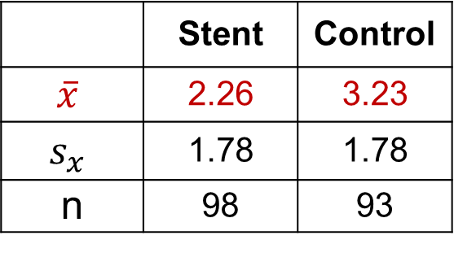












The Data: The actual difference in mean disability score from the experiment ${\overline{x}}_{s}−{\overline{x}}_{c}=−0.97$
 | Stent | Control
$$\overline{x}$$ | 2.26 | 3.23
$$s_{x}$$ | 1.78 | 1.78
n | 98 | 93
$${\overline{x}}_{s}−{\overline{x}}_{c}$$
$${\overline{x}}_{s}−{\overline{x}}_{c}$$
How unlikely was our data?
Probability of getting this result or more extreme? p-value=0.0001
$${\overline{x}}_{s}−{\overline{x}}_{c}$$
$${\overline{x}}_{s}−{\overline{x}}_{c}$$
$${\overline{x}}_{s}−{\overline{x}}_{c}$$
$${\overline{x}}_{s}−{\overline{x}}_{c}$$
$${\overline{x}}_{s}−{\overline{x}}_{c}$$
$${\overline{x}}_{s}−{\overline{x}}_{c}$$
$${\overline{x}}_{s}−{\overline{x}}_{c}$$
$${\overline{x}}_{s}−{\overline{x}}_{c}$$
$${\overline{x}}_{s}−{\overline{x}}_{c}=−0.97$$
$${\overline{x}}_{s}−{\overline{x}}_{c}$$
$${\overline{x}}_{s}−{\overline{x}}_{c}$$
$${\overline{x}}_{s}−{\overline{x}}_{c}$$
$${\overline{x}}_{s}−{\overline{x}}_{c}$$
$${\overline{x}}_{s}−{\overline{x}}_{c}$$
$${\overline{x}}_{s}−{\overline{x}}_{c}$$
$${\overline{x}}_{s}−{\overline{x}}_{c}$$
$${\overline{x}}_{s}−{\overline{x}}_{c}$$
$${\overline{x}}_{s}−{\overline{x}}_{c}$$
$${\overline{x}}_{s}−{\overline{x}}_{c}$$
$${\overline{x}}_{s}−{\overline{x}}_{c}$$
$${\overline{x}}_{s}−{\overline{x}}_{c}$$
-1.25
-0.97
-.75
-.50
-.25
0
.25
.50
.75
Very unlikely!
This probability

Slide 38
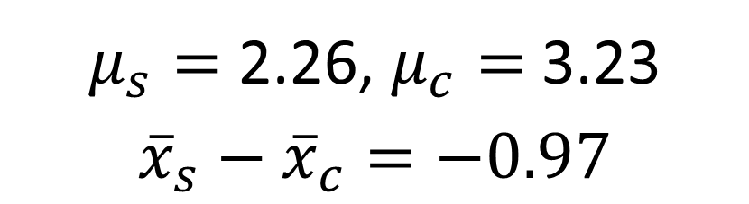
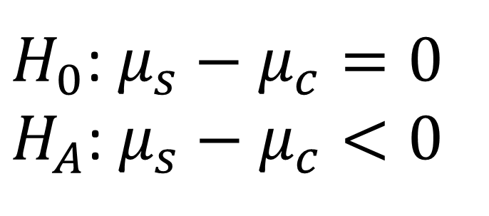
Recap: The Test
Is there convincing statistical evidence that the stent lowered the average disability from stroke?
$H_{0}$: $μ_{s}−μ_{c}=0$
$H_{A}$: $μ_{s}−μ_{c}<0$
$μ_{s}=$ 2.26, $μ_{c}=$ 3.23
$${\overline{x}}_{s}−{\overline{x}}_{c}=−0.97$$

Slide 39
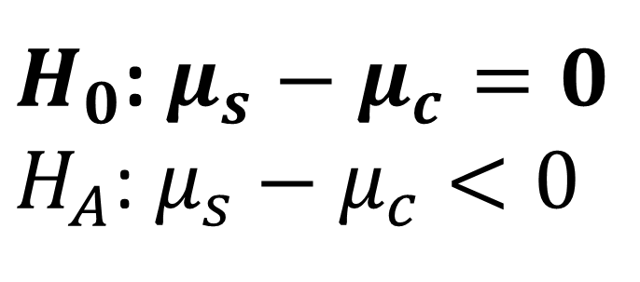
Recap: The Test
Is there convincing statistical evidence that the stent lowered the average disability from stroke?
$H_{0}$: $μ_{s}−μ_{c}=0$
$H_{A}$: $μ_{s}−μ_{c}<0$
$μ_{s}=$ 2.26, $μ_{c}=$ 3.23
$${\overline{x}}_{s}−{\overline{x}}_{c}=−0.97$$
1. Assume null is true

Slide 40
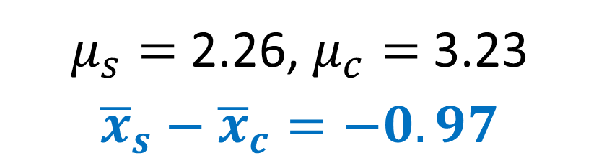
Recap: The Test
Is there convincing statistical evidence that the stent lowered the average disability from stroke?
$H_{0}$: $μ_{s}−μ_{c}=0$
$H_{A}$: $μ_{s}−μ_{c}<0$
$μ_{s}=$ 2.26, $μ_{c}=$ 3.23
$${\overline{x}}_{s}−{\overline{x}}_{c}=−0.97$$
1. Assume null is true
2. How unlikely was our sampled data?
p-value: 0.0001

Slide 41
Recap: The Test
Is there convincing statistical evidence that the stent lowered the average disability from stroke?
$H_{0}$: $μ_{s}−μ_{c}=0$
$H_{A}$: $μ_{s}−μ_{c}<0$
$μ_{s}=$ 2.26, $μ_{c}=$ 3.23
$${\overline{x}}_{s}−{\overline{x}}_{c}=−0.97$$
Our sample data was very unlikely, if we assume the null is true.
2. How unlikely was our sampled data?
p-value: 0.0001

Slide 42

Conclude
Note: more concise conclusion template provided later
3. Draw a conclusion:
$H_{0}$: $μ_{s}−μ_{c}=0$
$H_{A}$: $μ_{s}−μ_{c}<0$
Under my assumption that stents provide no added benefit, the actually observed data (0.97 point decline in disability in stent group) is highly unlikely (p-value = 0.0001). So, I reject my earlier assumption. There’s convincing evidence that the stent lowers disability from stroke.

Slide 43
Topics
Two-sample t-test for a difference of means
Four step process

Slide 44

The Four Steps for Inference
A suggested way to organize your work so that you get full credit on FRQ’s!
State: hypotheses, significance level, and define your parameters
Plan: Name your inference method and check conditions
Do: Perform calculations (if conditions met), report the test statistic and the p-value
Conclude: Reject or fail to reject $H_{0}$ and justify

Slide 45


State-Plan-Do-Conclude
State: State the hypotheses, significance level, and define your parameters
$H_{0}$: $μ_{s}−μ_{c}=0$
$H_{A}$: $μ_{s}−μ_{c}<0$
α = 0.05
Where:
$μ_{s}$ is the mean disability score of all patients who’d receive stents.
$μ_{c}$is the mean disability score of all patients who’d receive current standard of care.

Slide 46

State-Plan-Do-Conclude
Plan: Name your inference method and check conditions
We will conduct a two-sample t-test for $μ_{s}−μ_{c}$.
$\frac{(\overline{X_{s}}−\overline{X_{c}})−0}{\sqrt{\frac{{s_{s}}^{2}}{n_{s}}+\frac{{s_{c}}^{2}}{n_{c}}}} \sim t(df)$ if the following conditions are met. if all conditions are met.
df=?

Slide 47





State-Plan-Do-Conclude
Plan: Name your inference method and check conditions
We will conduct a two-sample t-test for $μ_{s}−μ_{c}$, if all conditions are met.
Conditions
1. Random: Patients were randomly
assigned either to receive current
standard care or stent treatment.
2. Normal/Large Samples:
$$n_{s}≥30$$
$$98≥30$$
$$n_{c}≥30$$
$$93≥30$$

Slide 48
State-Plan-Do-Conclude
Do: Perform calculations (if conditions met), report the test statistic and the p-value
t = (formula) = -3.76
p-value =（formula）= 0.0001

Slide 49

State-Plan-Do-Conclude
Conclude: Reject or fail to reject $H_{0}$ and justify
Conclusions template: Because our p-value (____) is less/greater than our alpha level (___), we reject/fail to reject $H_{0}$. We do/don’t have convincing evidence that ($H_{A}$ in context).

Slide 50

State-Plan-Do-Conclude
Conclude: Reject or fail to reject $H_{0}$ and justify
Because our p-value (0.0001) is less than our alpha level (0.05), we reject $H_{0}$. We do have convincing evidence that stents lower disability from stroke.

Slide 51


Slide 52



